Slide 1
Warm-up
a. Solve for k: ${13}^{−5k}−10=56$
b. Solve for x: $\log_{3}{x}+\log_{3}\left(x+2\right)=1$

Slide 2
MATRICES
MATRIX OPERATIONS

Slide 3
A matrix is a rectangular arrangement of numbers in rows and columns. Rows run horizontally and columns run vertically.
The dimensions of a matrix are stated “m x n” where ‘m’ is the number of rows and ‘n’ is the number of columns.

Slide 4
EQUAL MATRICES
Two matrices are considered equal if they have the same number of rows and columns (the same dimensions) AND all their corresponding elements are exactly the same.

Slide 5
SPECIAL MATRICES
Some matrices have special names because of what they look like.
Row matrix: only has 1 row.
Column matrix: only has 1 column.
Square matrix: has the same number of rows and columns.
Zero matrix: contains all zeros.

Slide 6
MATRIX ADDITION
MATRIX ADDITION AND SUBTRACTION
You can add or subtract matrices if they have the same dimensions (same number of rows and columns).
To do this, you add (or subtract) the corresponding numbers (numbers in the same positions).

Slide 7
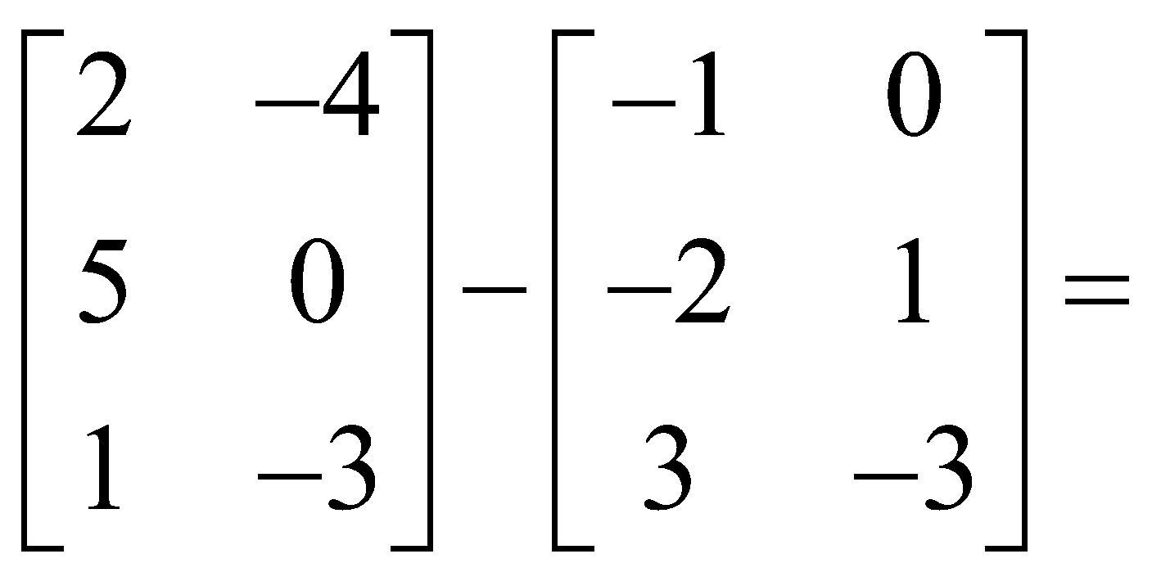
MATRIX ADDITION
Example:

Slide 8
SCALAR MULTIPLICATION
SCALAR MULTIPLICATION
To do this, multiply each entry in the matrix by the number outside (called the scalar). This is like distributing a number to a polynomial.

Slide 9
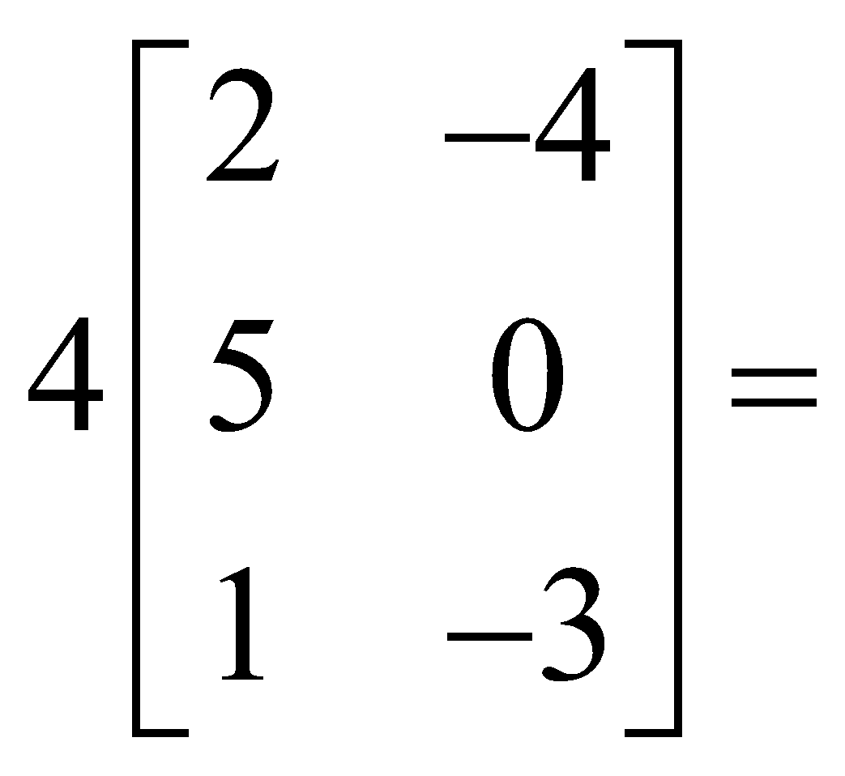
SCALAR MULTIPLICATION

Slide 10
Multiplication of Matrices by HAND!
64
74
Work:
1(3) + 7(7) + 3(4) = 64
1(5) + 7(9) + 3(2) = 74
5(3) + 5(7) + 9(4) = 86
5(5) + 5(9) + 9(2) = 88
86
88
2x3 ∙ 3x2
2x2

Slide 11
You try one by hand..

Slide 12
Warm-up
Divide x³ – 2x² -8x – 35 by (x – 5)
Hint: Synthetic division
2. Given $y=({2x+1)}^{3}$, find $\frac{dy}{dx}$
Hint: Chain rule

Slide 13
MATRIX DETERMINANTS
A Determinant is a real number associated with a matrix. Only SQUARE matrices have a determinant.
The symbol for a determinant can be the phrase “det” in front of a matrix variable, det(A); or vertical bars around a matrix, |A| or
$\left|\begin{matrix}a & b \\ c & d\end{matrix}\right|$= $ad−bc$

Slide 14
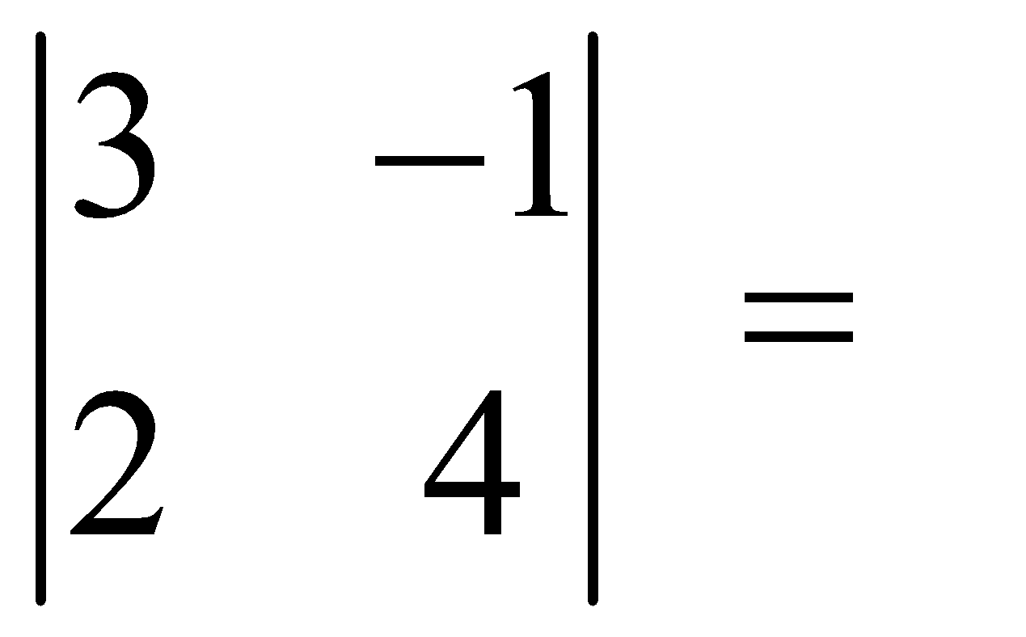
MATRIX DETERMINANTS
To find the determinant of a 2 x 2 matrix, multiply diagonal #1 and subtract the product of diagonal #2.
$\left|\begin{matrix}a & b \\ c & d\end{matrix}\right|$= $ad−bc$
Diagonal 2 = -2
Diagonal 1 = 12

Slide 15
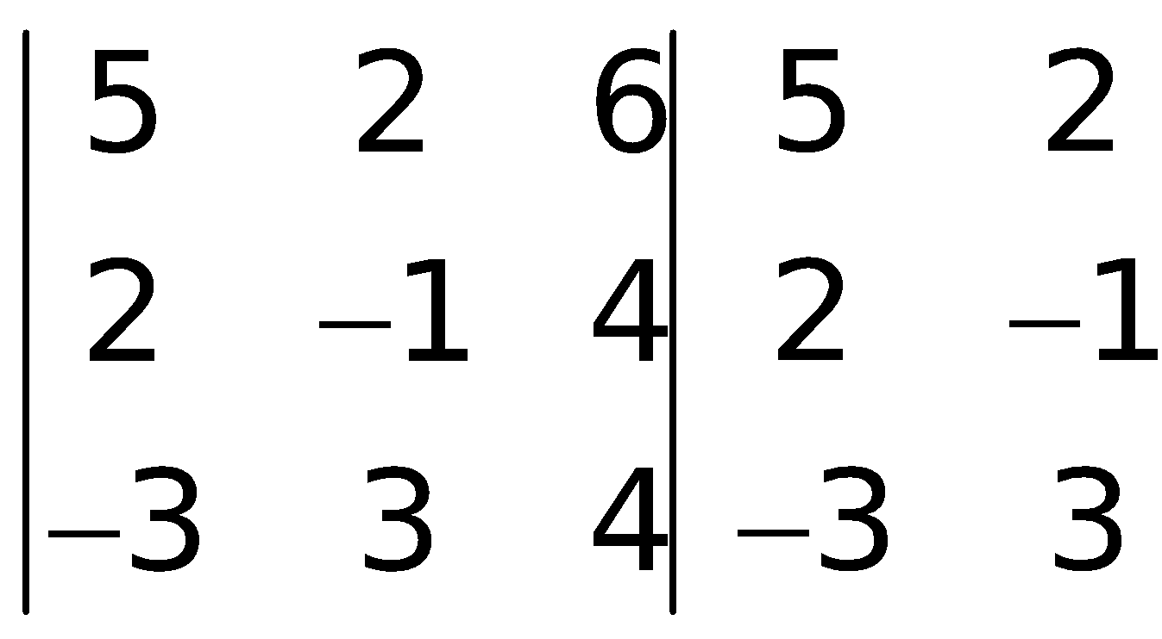
MATRIX DETERMINANTS
To find the determinant of a 3 x 3 matrix, first recopy the first two columns. Then do 6 diagonal products.
18
60
16
-20
-24
36

Slide 16
MATRIX DETERMINANTS
The determinant of the matrix is the sum of the downwards products minus the sum of the upwards products.
18
60
16
= (-8) - (94) = -102
-20
-24
36

Slide 17
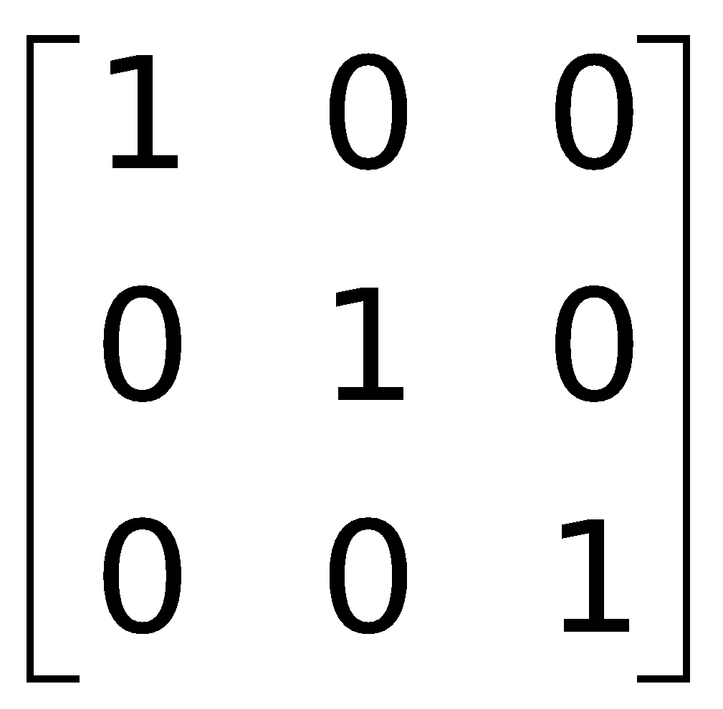
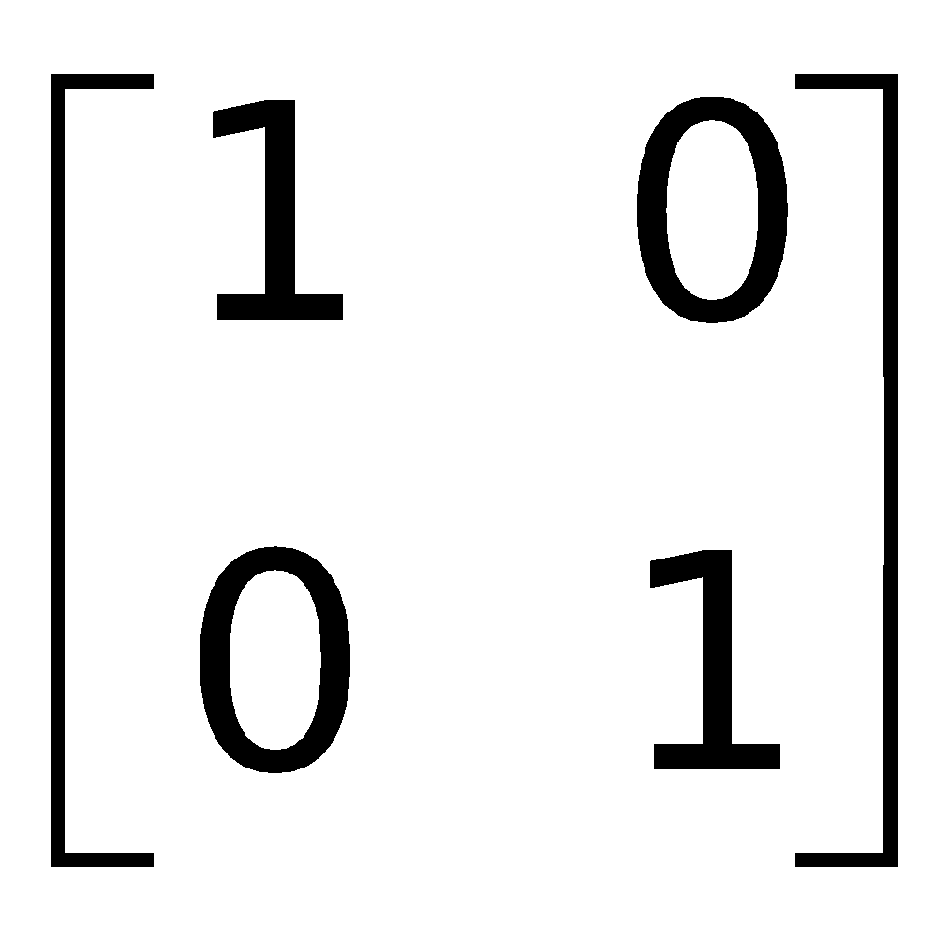
IDENTITY MATRICES
An identity matrix is a square matrix that has 1’s along the main diagonal and 0’s everywhere else.
*When you multiply a matrix by the identity matrix, you get the original matrix*

Slide 18
INVERSE MATRICES
When you multiply a matrix and its inverse, you get the identity matrix.
$$\left[\begin{matrix}3 & −1 \\ −5 & 2\end{matrix}\right]\left[\begin{matrix}2 & 1 \\ 5 & 3\end{matrix}\right]=\left[\begin{matrix}1 & 0 \\ 0 & 1\end{matrix}\right]$$

Slide 19
INVERSE MATRICES
Not all matrices have an inverse!
To find the inverse of a 2 x 2 matrix, first find the determinant.
If the determinant = 0, the inverse does not exist!
The inverse of a 2 x 2 matrix is the reciprocal of the determinant times the matrix with the main diagonal swapped and the other terms multiplied by -1.
$$A^{−1}=\frac{1}{det⁡(A)}\left[\begin{matrix}d & −b \\ −c & a\end{matrix}\right]$$

Slide 20
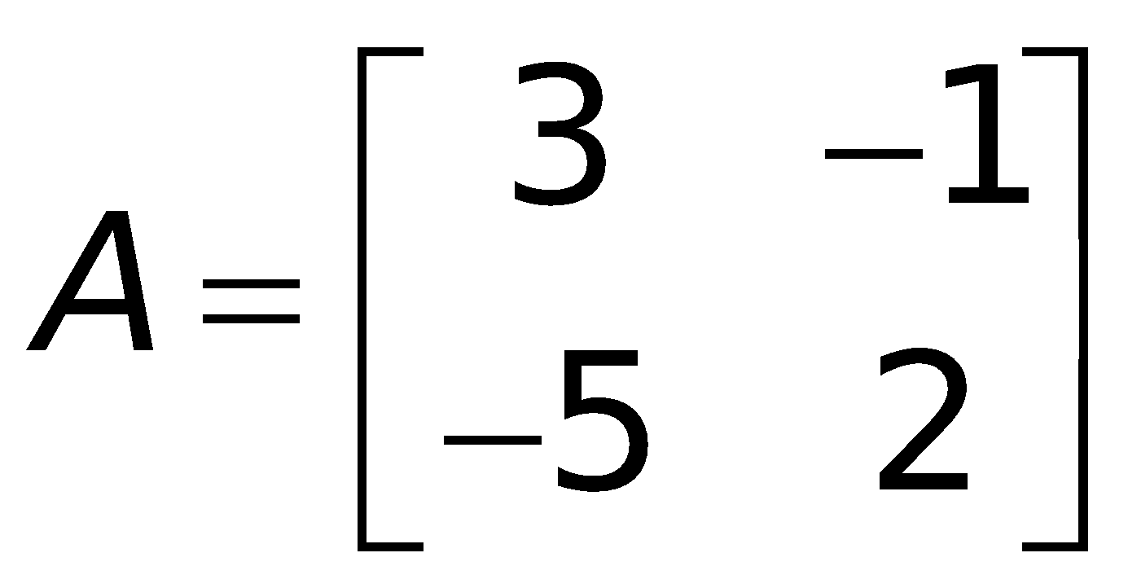
INVERSE MATRICES
$$A^{−1}=\frac{1}{det⁡(A)}\left[\begin{matrix}d & −b \\ −c & a\end{matrix}\right]$$
$$\det\left(A\right)=6−5=1$$
How could you check to see if the inverse is correct?

Slide 21
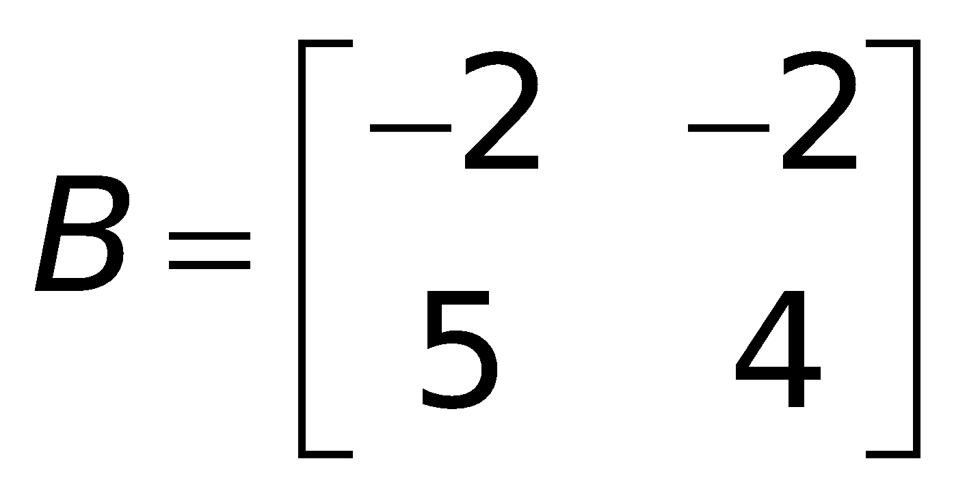
Find the inverse of matrix b:

