Slide 1
Particle Motion
https://www.youtube.com/watch?v=ZM8ECpBuQYE

Slide 2
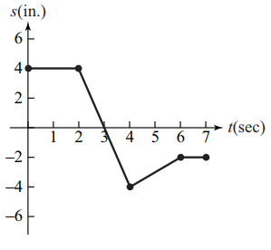
The graph shows the position s(t) of a particle moving along a horizontal coordinate axis.
When is the particle moving left?
When is the particle moving right?
When is the particle standing still?
(2, 4)
(4, 6)
[0, 2]U [6, 7]

Slide 3
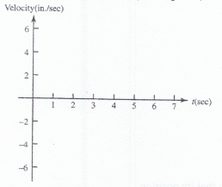
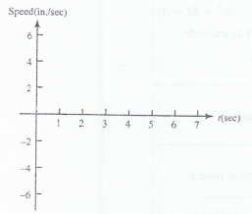

d. Graph the particle’s velocity and speed (where defined)
Keep in mind: $Velocity=\frac{∆ position}{∆ time}$ and $Speed=|Velocity|$
e. When is the particle moving fastest?

Slide 4
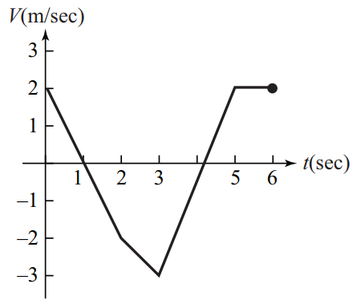
The graph shows the velocity v=f(t) of a particle moving along a horizontal coordinate axis.
When does the particle reverse direction?
When is the particle moving at a constant speed?
When is the particle moving at its greatest speed?
t=1, 4.25 sec
(5, 6) sec
t = 3 sec

Slide 5
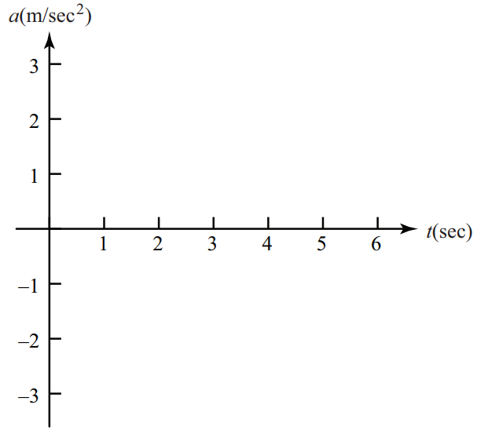

d. Graph the acceleration (where defined)
Keep in mind: $Acceleration=\frac{∆ Velocity}{∆ time}$

Slide 6
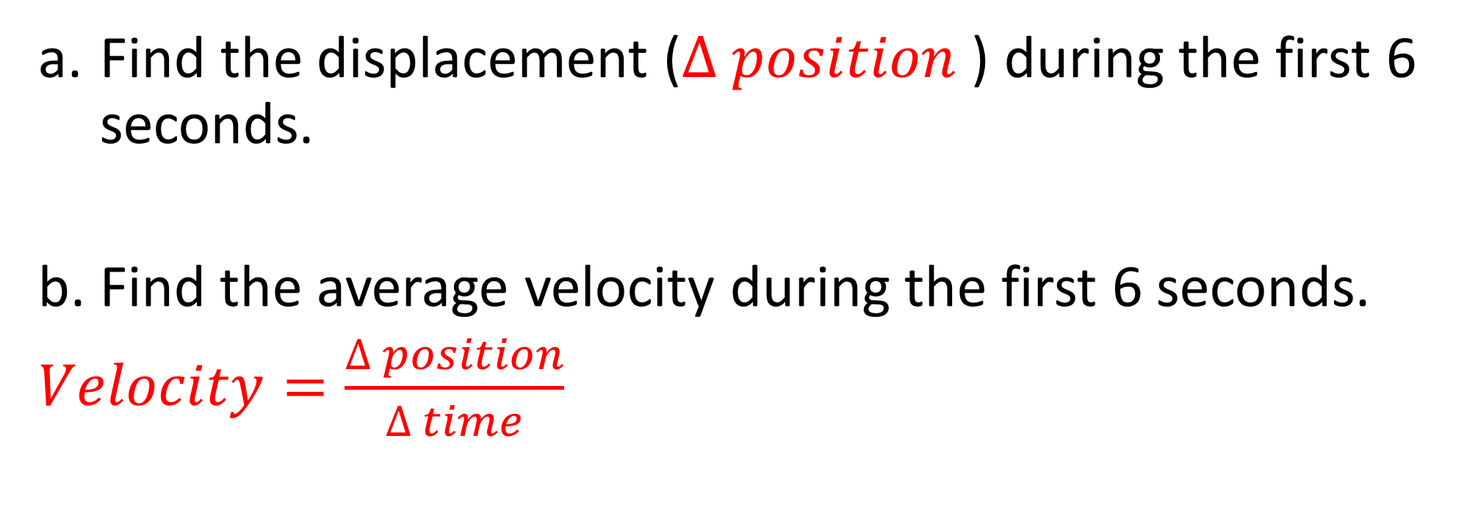
A particle moves along a vertical coordinate axis so that its position at any time t $≥0$ is given by the function $g\left(t\right)=\frac{1}{3}t^{3}−{3t}^{2}+8t−4.$
Find the displacement ($∆ position$) during the first 6 seconds.
b. Find the average velocity during the first 6 seconds.
$Velocity=\frac{∆ position}{∆ time}$
g(6) – g(0) = 8 – (-4) = 12
$$\frac{g\left(6\right)−g(0)}{6−0}=\frac{12cm}{6 sec}=2 cm/s$$

Slide 7
c. Find expressions for the velocity and acceleration at time t. Hmm..
$Velocity=\frac{∆ position}{∆ time} AKA SLOPE$ of the position function
And
$Acceleration=\frac{∆ Velocity}{∆ time} AKA SLOPE$of the velocity function
So if the position at time t is modeled by $g\left(t\right)=\frac{1}{3}t^{3}−{3t}^{2}+8t−4$
Velocity at time t can be modeled by: v$\left(t\right)=t^{2}−6t+8$
Acceleration at time t can be modeled by: a$\left(t\right)=2t−6$

Slide 8
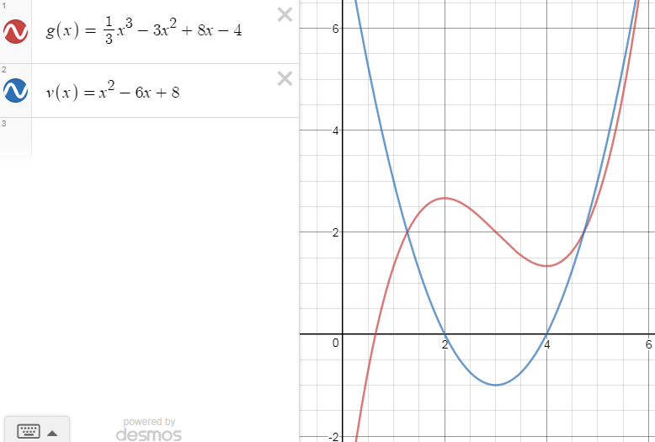
d. For what values of t is the particle moving downward?
Look at the graph of either the position function or the velocity function!
(2, 4) on the red graph (position) shows a negative slope
(2, 4) on the blue graph shows a negative velocity (movement in the negative direction)

